Slide 1
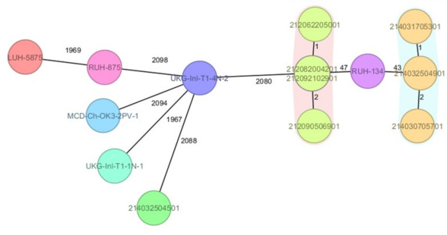
An introduction to using sequence data for the epidemiology of pathogens
Aldert Zomer, Soe Yu Naing, Jaap Wagenaar, Linda van der Graaf-van Bloois
Utrecht University – Infectious Diseases and Immunology

Slide 2
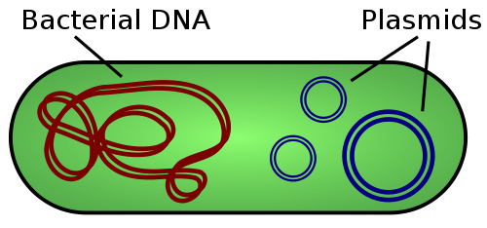
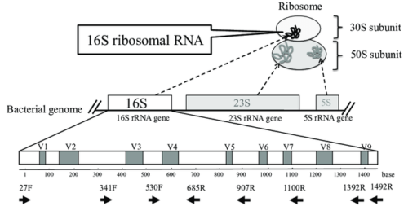
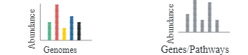
Tracking pathogens using sequencing
Genome Sequencing (WGS)
Amplicon Sequencing (16S, 18S, ITS)
Shotgun Metagenome sequencing

Slide 3
Microbial sequencing projects
Millions of microbial genomes
Sanger sequencing
Next generation sequencing (NGS)
454
Illumina
Nanopore
The global
ocean sampling
for metagenomics
First multicellular
organism: C. elegans
Microbial Sequencing projects
1000 genomes
6 weeks
<100 €/ genome
First bacteria:
H. influenzae
1 genome
2 years
100k €/ genome
2015
2020
2016
Complete genomes
Draft genomes

Slide 4
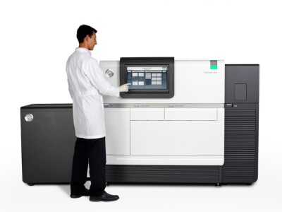
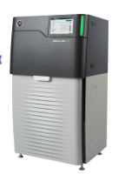
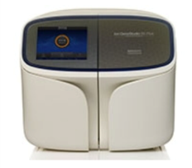
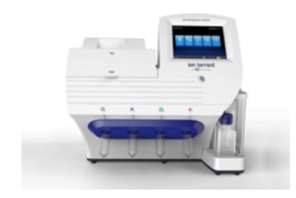
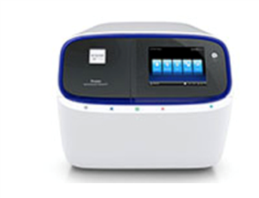
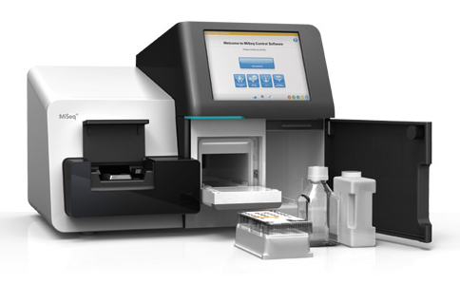
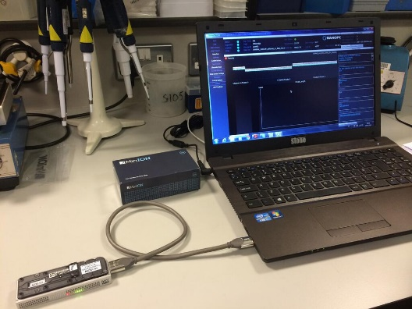
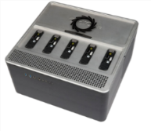
Sequencing tech
Pacific Biosystems
(PacBio)
IonTorrent
Short read
Ion Gene S5
Ion PGM
Ion Proton
cheap, fast, sequence errors,
200-400 bp reads
Long reads (20 kb)
Perfect for genome assembly
Moderate to high error rate
Long read
Illumina
Oxford Nanopore Technologies
MiniSeq MiSeq NextSeq HiSeq HiSeqX NovaSeq
SmidgION
Tiny (minION)
Long reads (>50 kb)
Perfect for genome assembly
Moderate to high error rate
cheap, precise, slow, high-throughput, 50-300 bp reads
PromethION
GridION

Slide 5
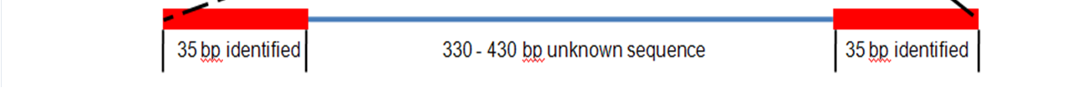
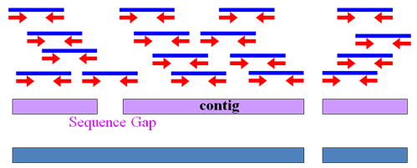
Short read sequencing
Fragmented DNA is sequenced into “reads”
Reads can be organized into read pairs
Read pairs can be puzzled together into “contigs”
Contigs can be ordered according to their expected position into “scaffolds”
Reads
Contigs
Scaffold

Slide 6
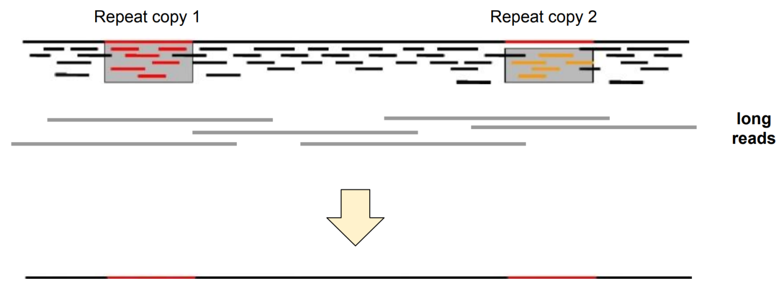
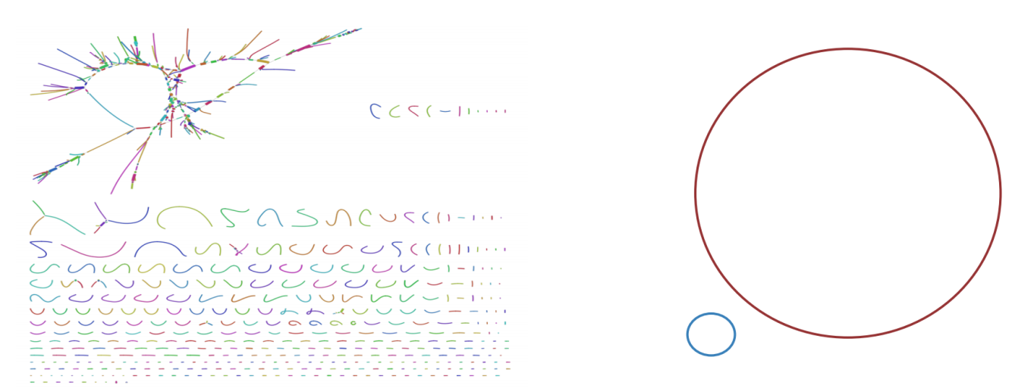
Long read sequencing
short reads: contig breaks
long reads span repeats
resulting in complete assemblies
Recognizing what is plasmid
and what is chromosomal DNA
short read assembly
long read assembly

Slide 7
Terminology: Sequence Alignment
Reference sequence
ACGCGATTCAGGTTACCAGCGTAGCGCATTA- CAC
Aligned sequence 1
ACGCGTTTCAGGTTACCAGCGTAGCGCATTAGCAC
Aligned sequence 2
ACGCGATTCAGGTTACCAGCGTACCGC –TTA -CAC
insertion
Single nucleotide polymorphism (SNP)
deletion
indel

Slide 8
Multi Locus Sequence Typing (MLST)
Web assigned :
ST
PCR
Sequencing
alleles
..GCTTG..
..TAGGC..
..ATGCA..
..TAAGA..
..ACTGA..
..CGCTG..
..GAATC..
2
3
1
1
4
4
3
purA
ack
sar
fdh
ST398
pta
cpn60
tuf
Housekeeping genes
(or core genes)
PCR product
Allelic
Sequences
Allelic type
Sequence type (ST)

Slide 9
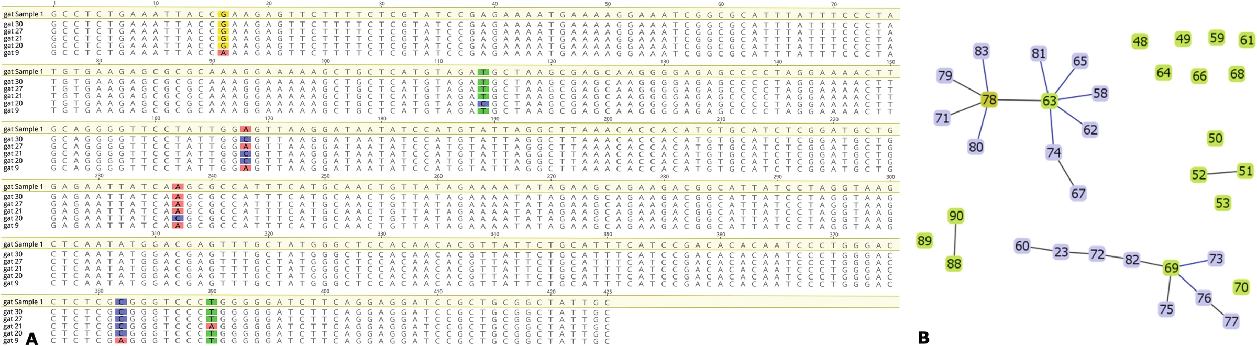
Multi Locus Sequence Typing (MLST)
Gene 1
Allele 1
1
1
1
1
2
Gene 2
Allele 1
2
1
2
2
1
Gene 3
Allele 1
1
1
2
1
3

Slide 10
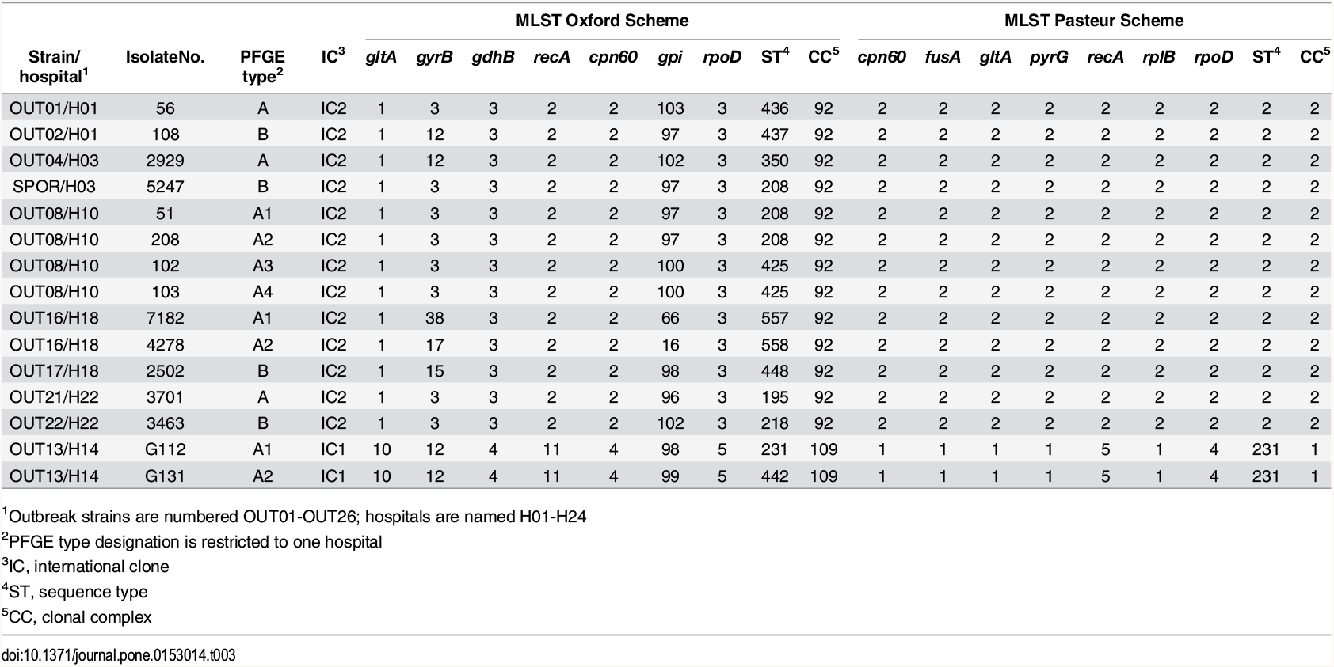
MLST scheme
Tree based on allelic profiles
Clonal
complex
1.0
0.8
0.6
Linkage Distance
0.4
0.2
0.0
20 11 29 9 21 13 11
Strain 8
Strain 5
Strain 3
Strain 2
Strain 9
Strain 4
Strain 7
Strain 6
Strain 12
Strain 11
Strain 1
Strain 10
Allelic Profile
11 15 30 12 22 11 20
11 15 30 12 22 11 20
Clone
11 15 30 12 22 11 20
1 5 3 5 2 8 4
1 5 3 7 2 8 4
20 11 29 9 21 13 11
1 5 3 7 2 8 4
9 15 13 27 22 18 14
11 15 30 12 22 11 20
6 5 9 1 2 13 17
9 10 1 19 12 18 14
Sequence Type (ST)
New STs: http://www.pubmlst.org

Slide 11
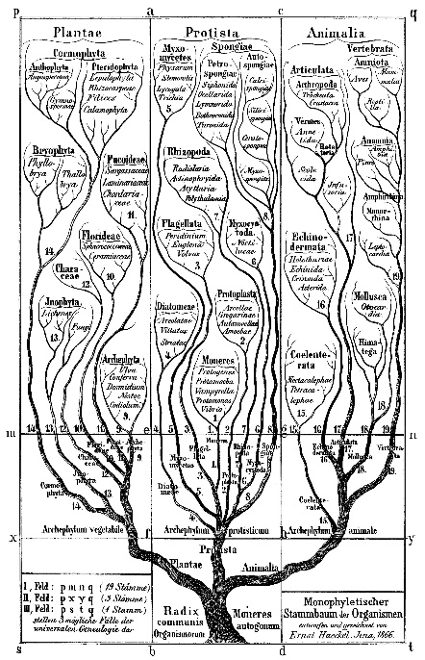
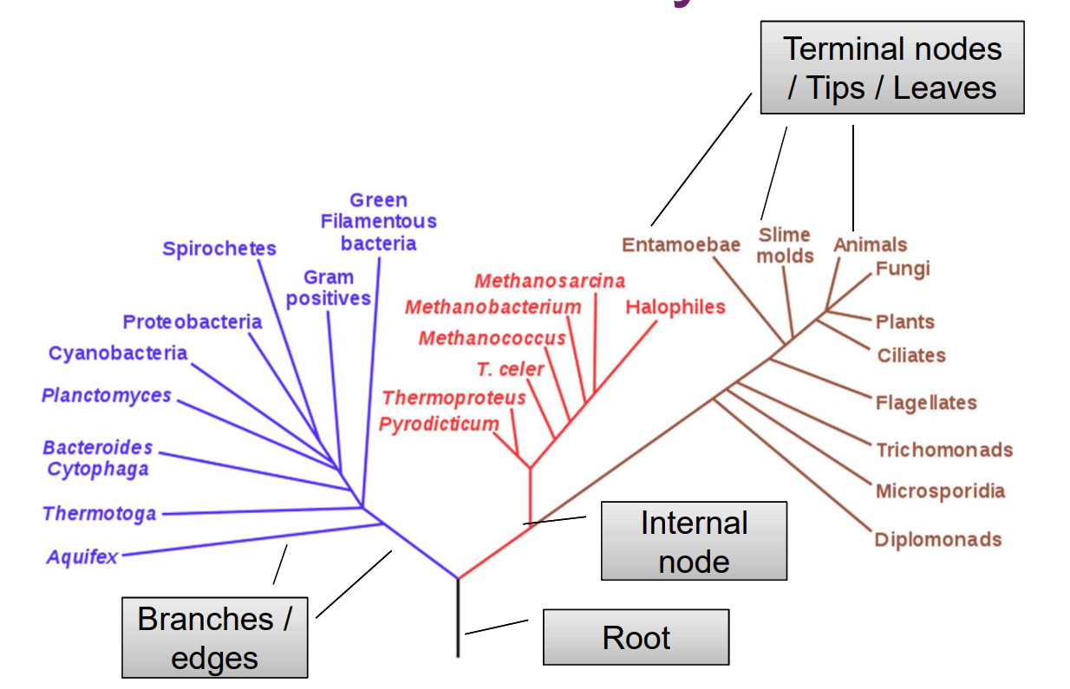
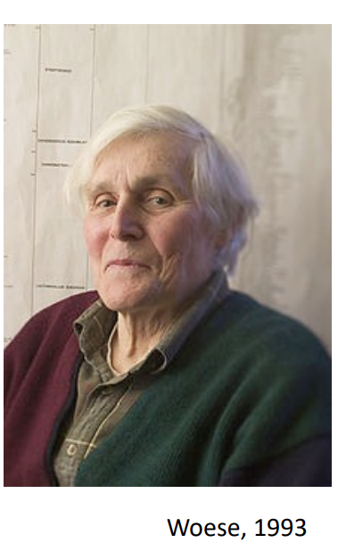
Visualizing sequences data: Trees
First tree based on genetic data – rRNA sequence tree

Slide 12
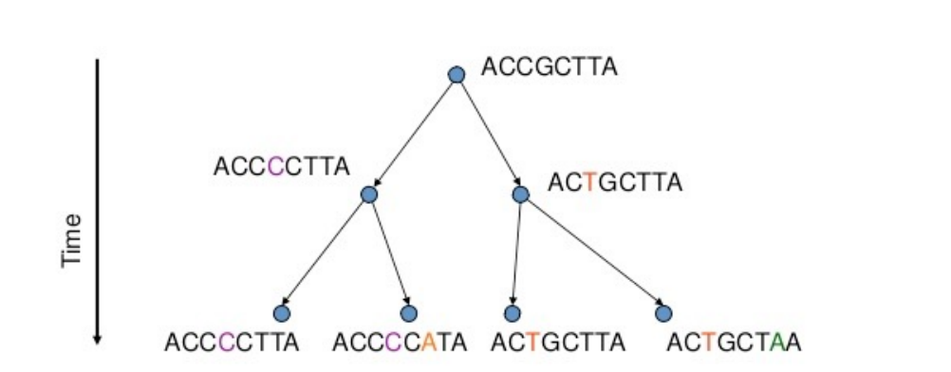
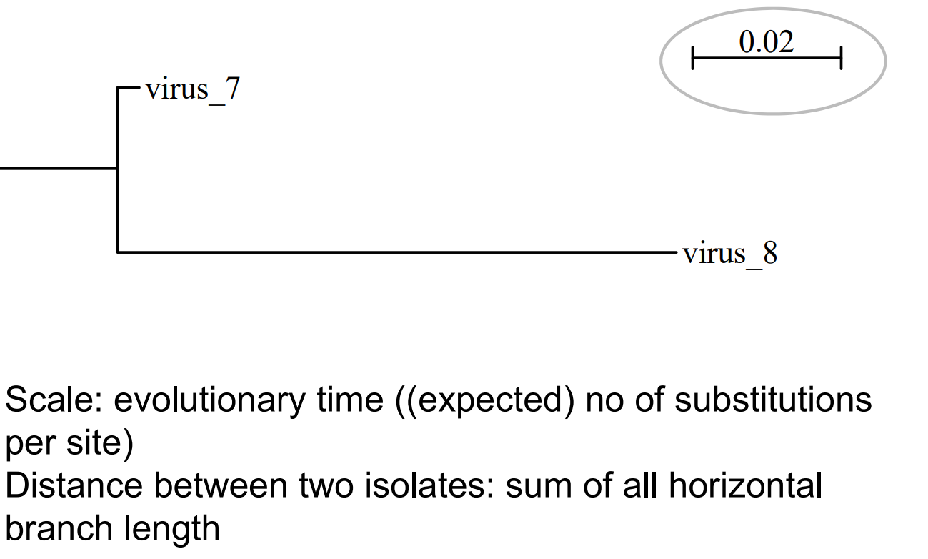
Only when microbes replicate, they make
mistakes in copying the DNA of their genome.
The rate of these changes is called the
“molecular clock”.
Using sequencing we can count how many
changes or mutations there are between isolates
The fewer mutations identified
between pairs of isolates, the less time since
divergence from a common ancestor.
Less SNPs = higher chance you are seeing a transmission event of the same strain
Some basics of bacterial genetics
This is what we observe

Slide 13
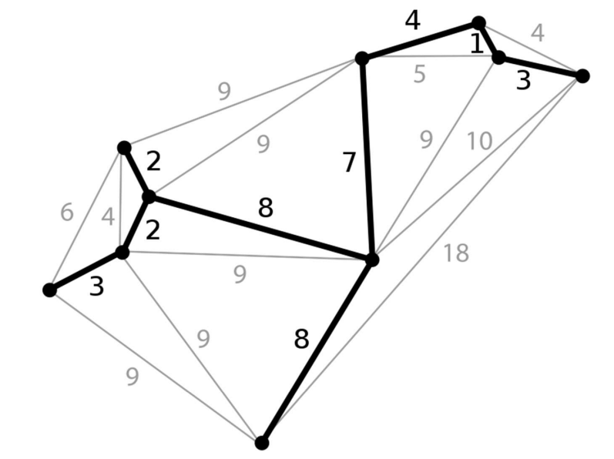
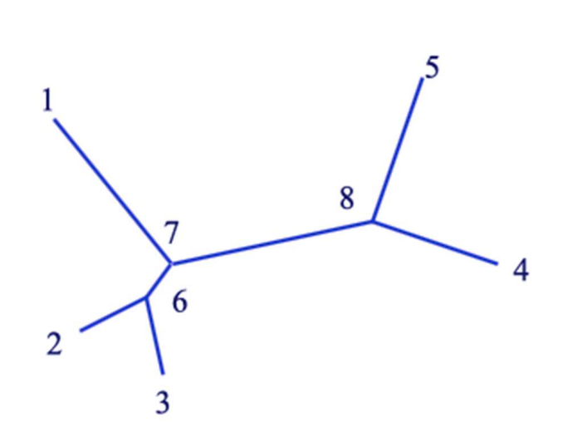
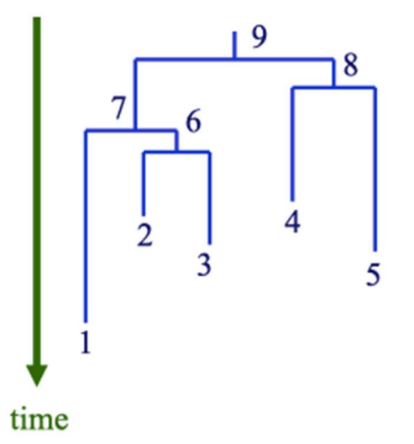
Types of trees
Minimum spanning tree
Phylogenetic tree
root
unrooted
rooted
Useful for outbreaks
Displays shortest connnections between isolates (= lowest number of SNPs)
Internal nodes are isolates
Useful for phylogenetic inference
Displays history of species/isolates in the tree
Internal nodes are inferred and not observed

Slide 14
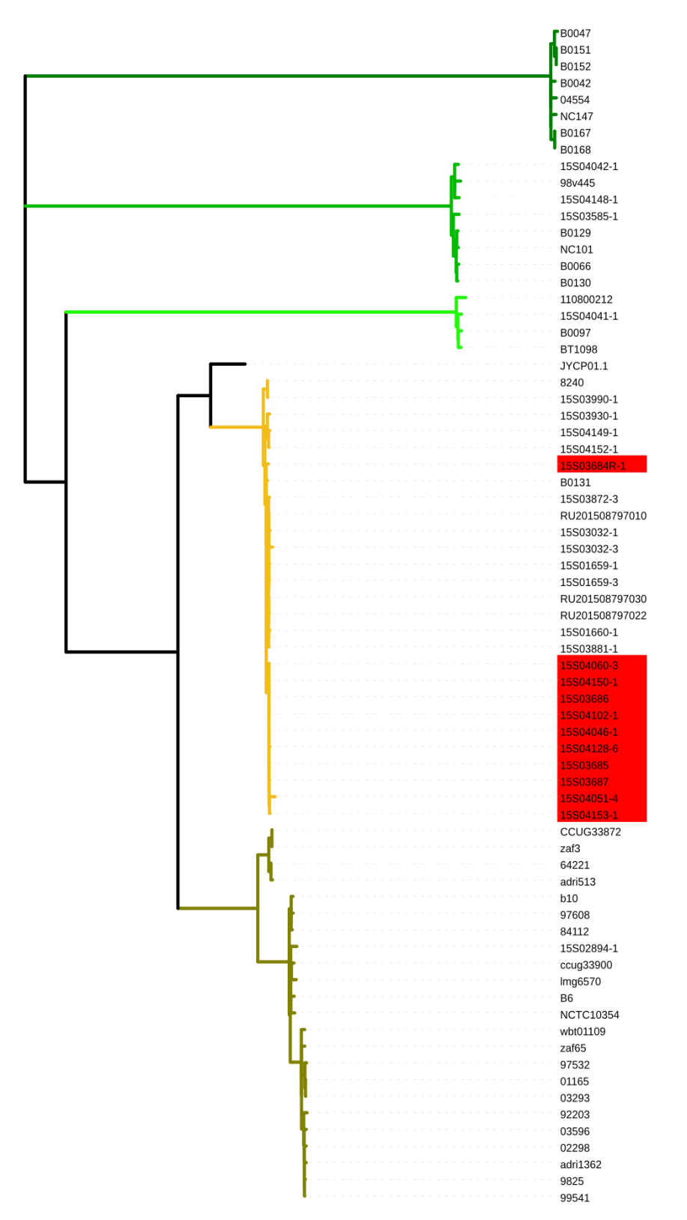
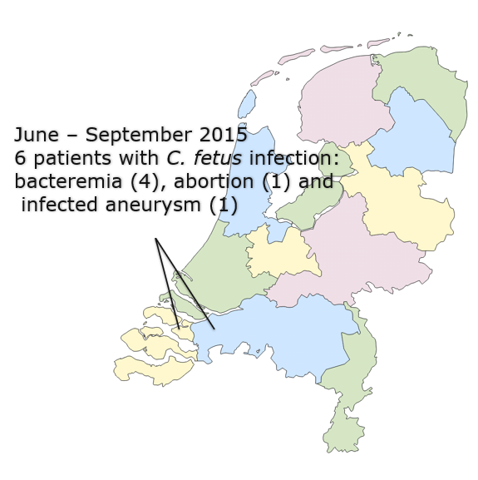
Example of pathogen tracking using WGS
Cff ST5
Cff ST3
Cff ST2
Cff ST6
Unpasteurized cheese from
sheep farm indicated
Cfv ST4
Unrelated patient isolates
Patient and sheep flock isolates
Ruminant ST6 isolates
Tree from core genome alignment

Slide 15
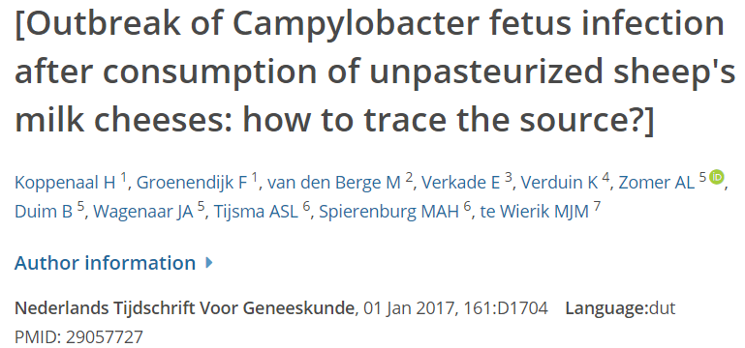
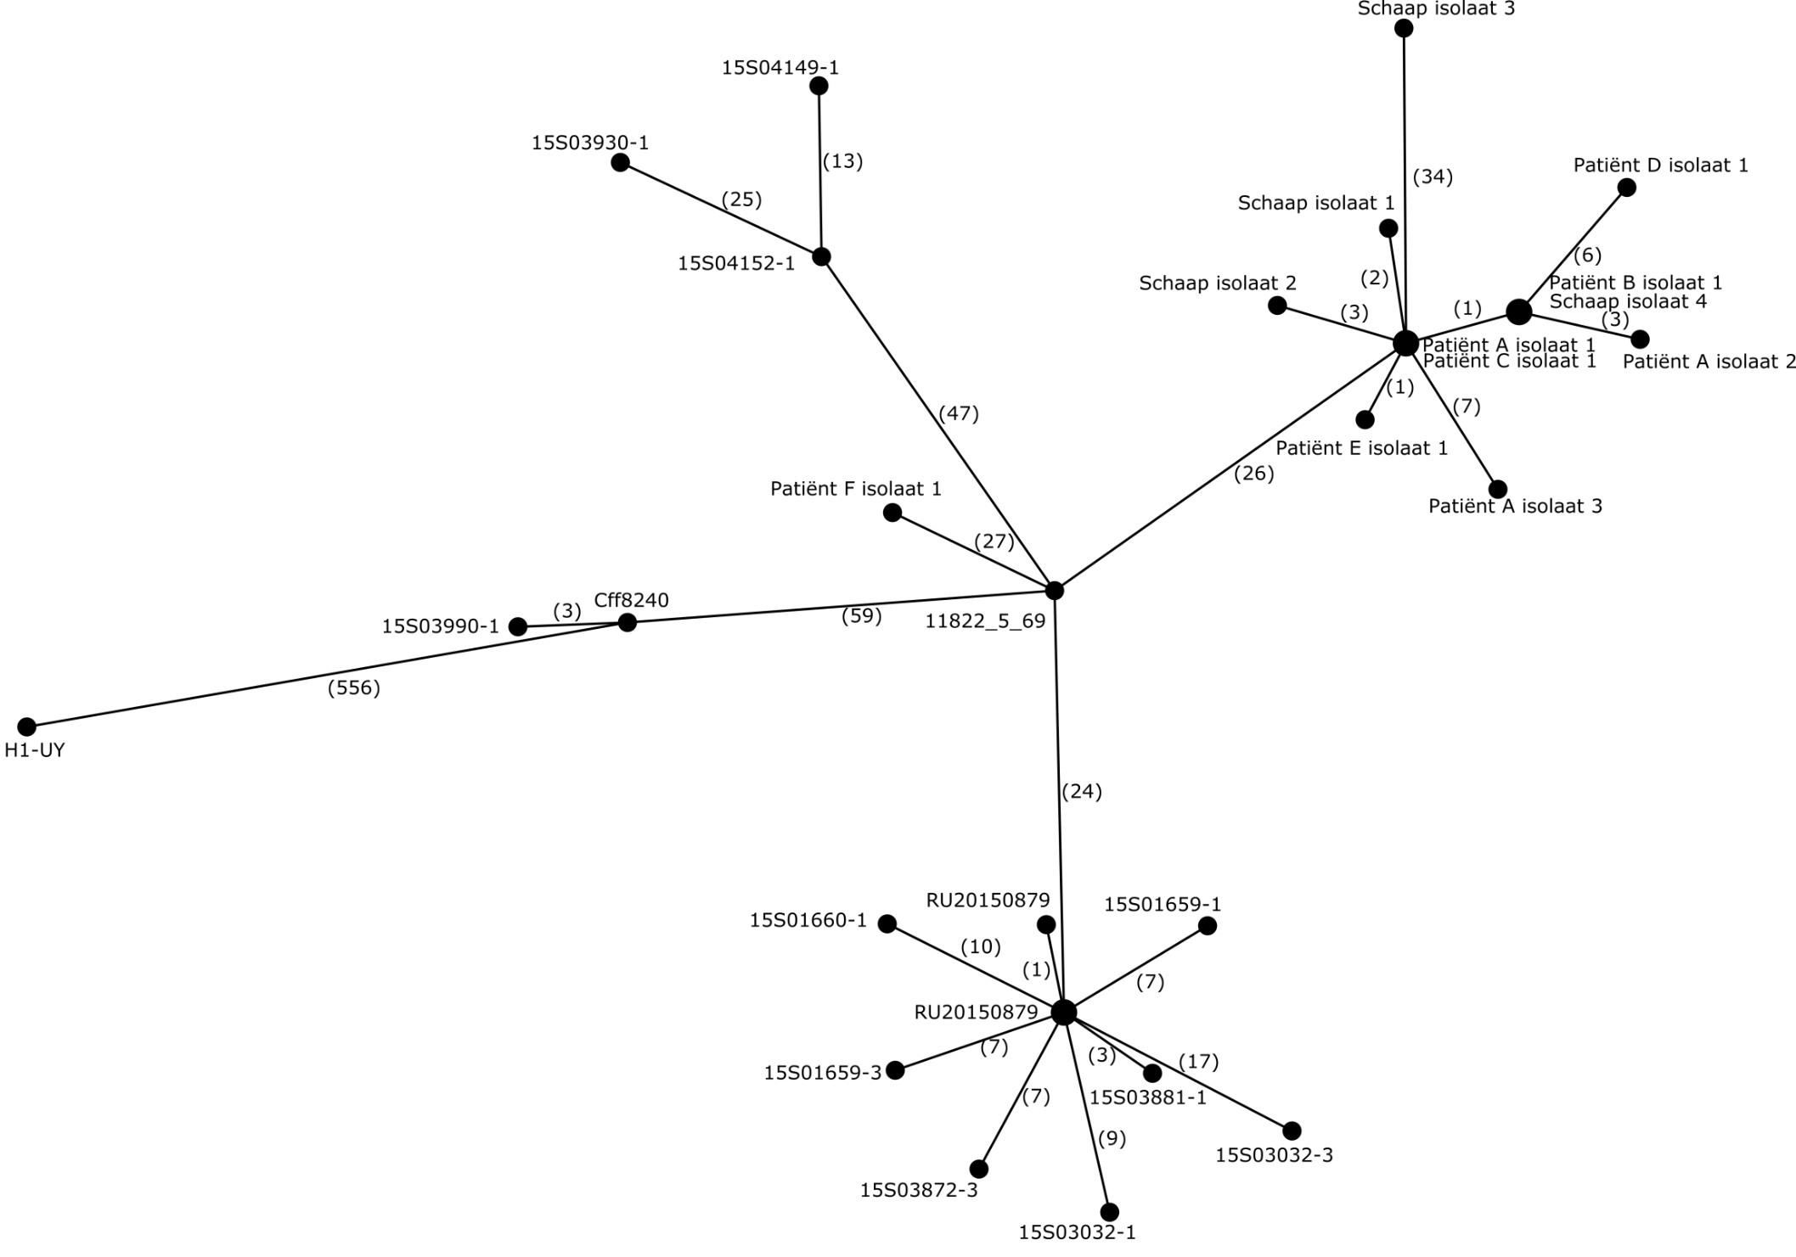
2015 Zeeland
outbreak
C. fetus reference
strain 82-40
Minimum Spanning Tree
ST6
core genome SNPs
Carriage study in cattle

Slide 16
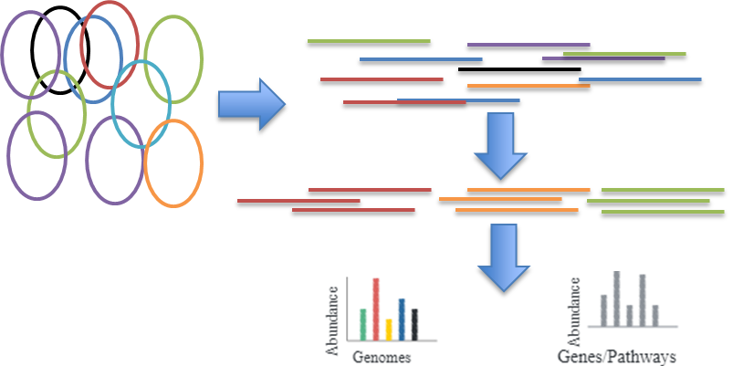
Tracking pathogens using sequencing
Genome Sequencing (WGS)
Amplicon Sequencing (16S, 18S, ITS, etc)
Shotgun Metagenome sequencing
From isolates
Directly from samples

Slide 17
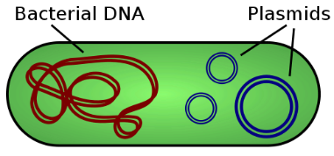
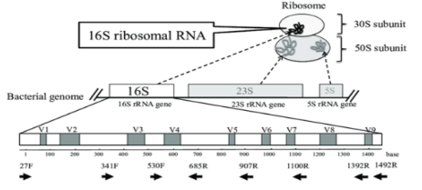
Take home messages
Tracking isolates, bacteria, functions using sequencing
Isolates (WGS), Amplicon (16S, 18S, ITS), Shotgun metagenomics
We can use short read and long read sequencing (Illumina, Nanopore)
We track strains using MLST and/or differences in SNPs
Outbreaks can be visualized using different trees (phylogenetic, minimum spanning)

